Slide 1

Engineers in Motion

Slide 2
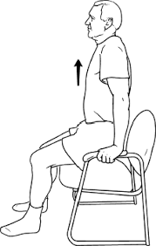
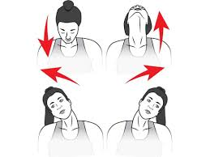

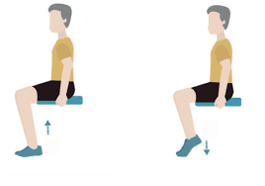
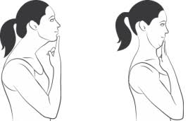
5-minute Exercise for the desk
FEELING STIFF OR UNCOMFORTABLE?
Chin Tucks
Isometric Floor Slides
Neck stretches
Chair Push Ups/Traction
Calf Raises
Hold for
30 sec for traction
Hold for
30 sec
2 sets of 15

Slide 3
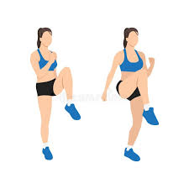
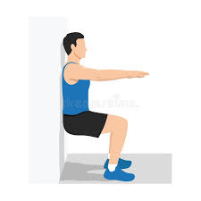
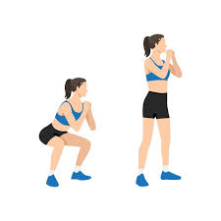
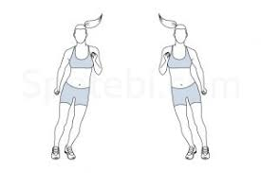
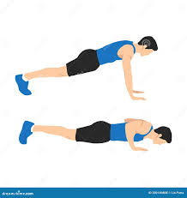
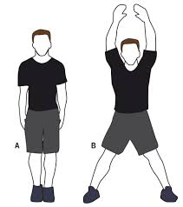
5-minute Exercise for Heart Rate
Need More Energy?
Squats / Jump Squats
Wall/ Chair Sits
Push-Ups
Jumping Jacks / Ski Jumps
High Knees

Slide 4
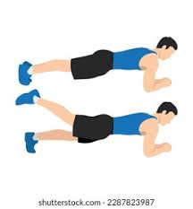
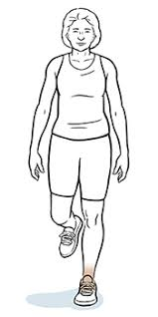
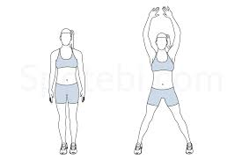
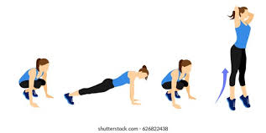
See How far you can go
Simple → Challenging
Mental Load Plyometrics
Jumping Jacks
Burpees
Nordic Hamstring Curls
Plank Competition
Single Leg Balance

Slide 5
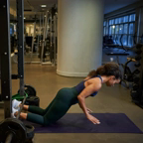
Nordic Hamstring Curls
Have a partner hold down your legs and go as far down as you can before pushing up with your hands

Slide 6
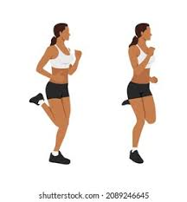
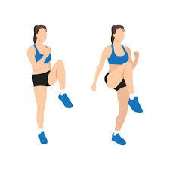

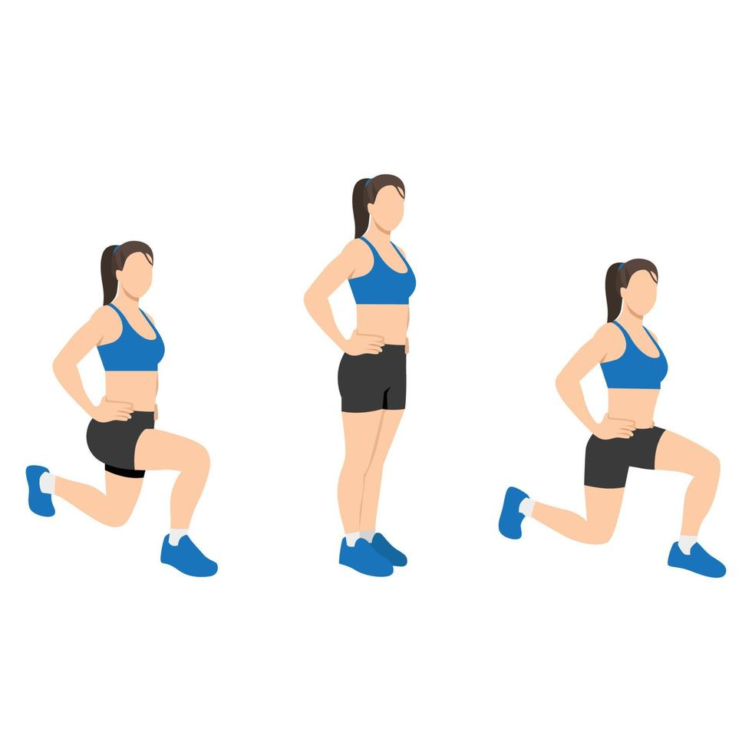
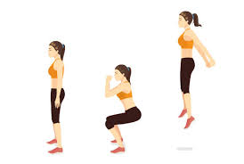
Complete the Challenge
Mental Load Plyometrics
1 min
Bunny Hops
x20
High Knees
x15
Squat Jumps
x5
Back Kicks
x15
Lunges
X10
If you finish, you get your name in a raffle for a prize

Slide 7
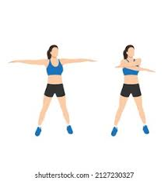
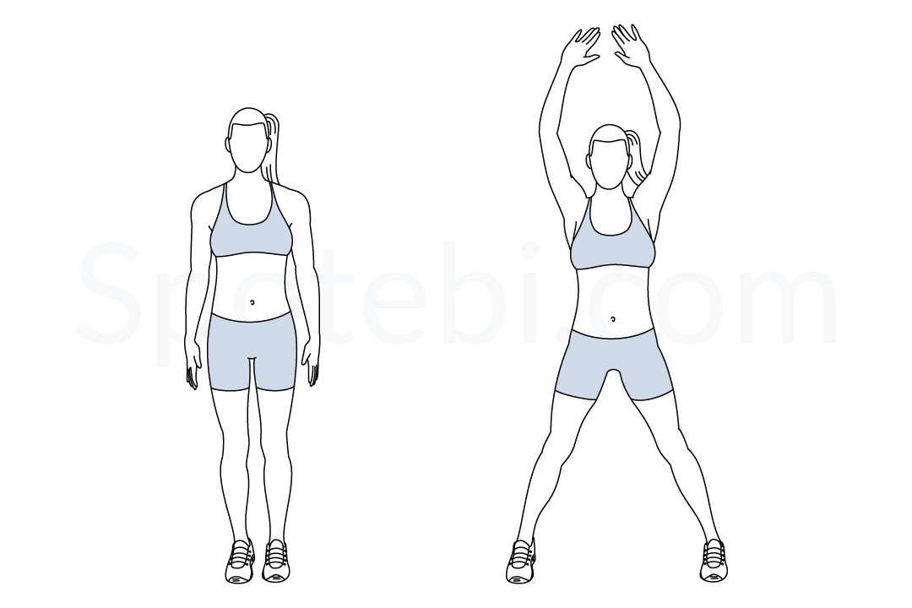
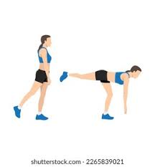
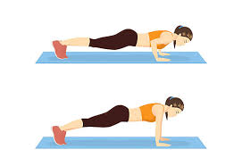
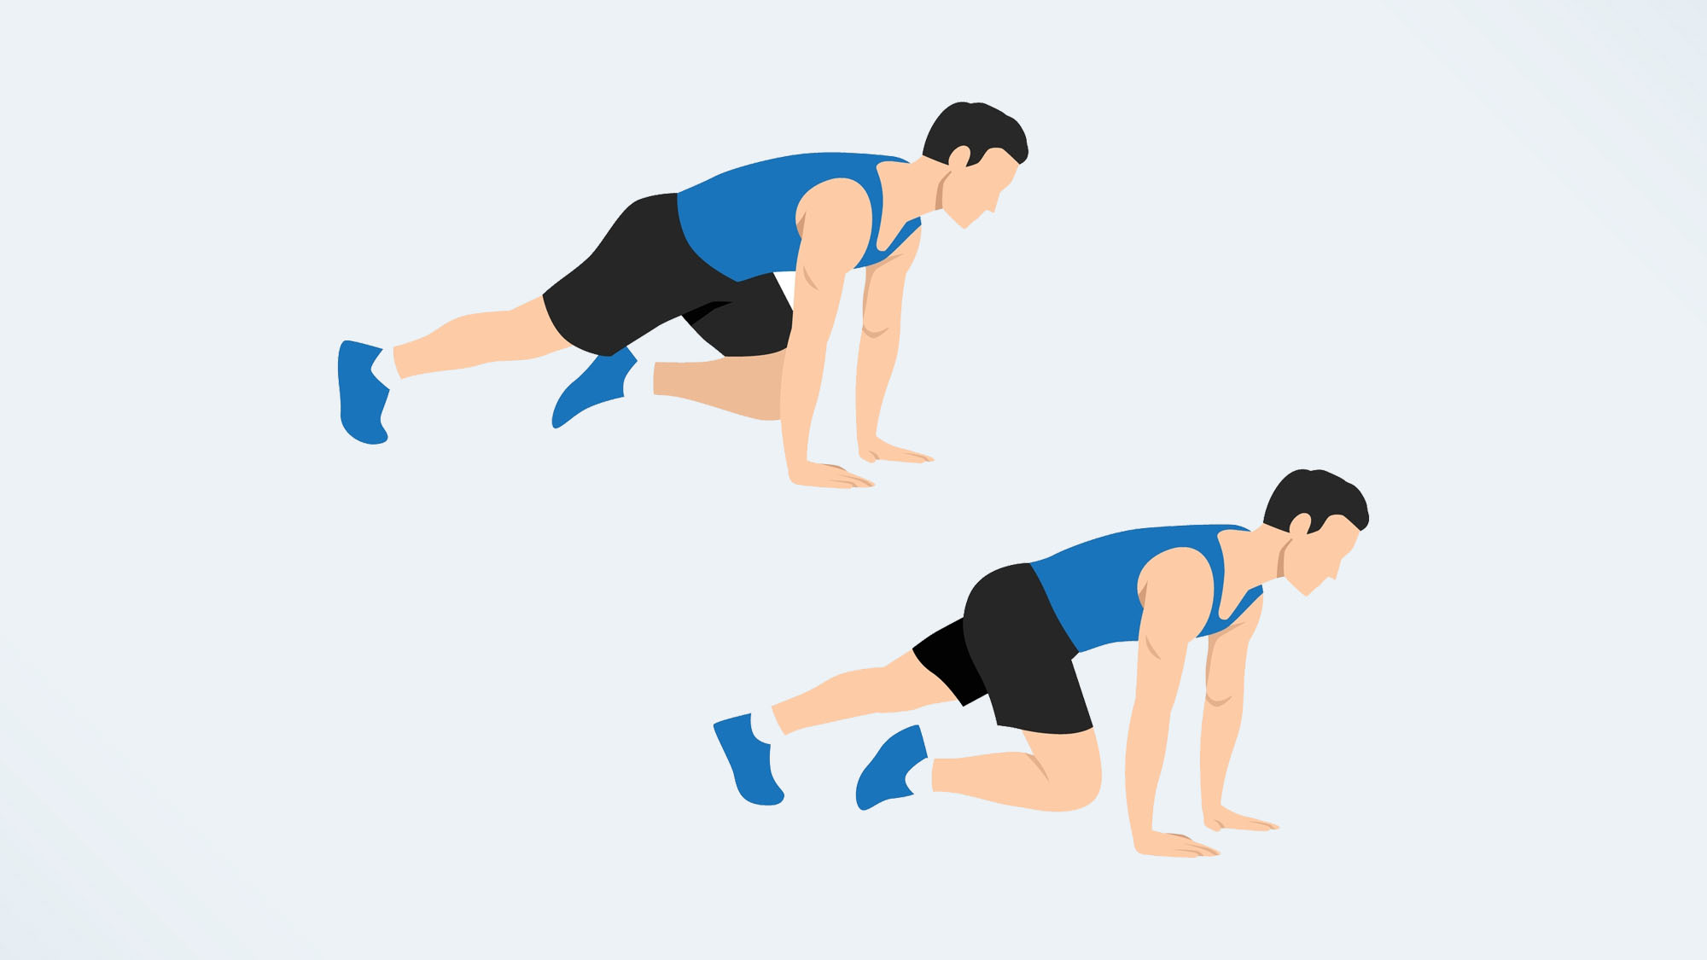
Complete the Challenge
Arm Swings
x15
Push-Ups
x5
Single Leg Romanian Dead Lifts
X 5 each side
Mountain Climbers
x10
Jumping Jacks
X10
Musical Candy Bar
If you finish, you get your name in a raffle for a prize

Slide 8
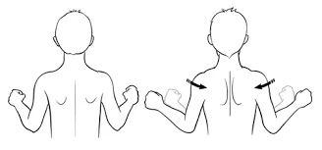
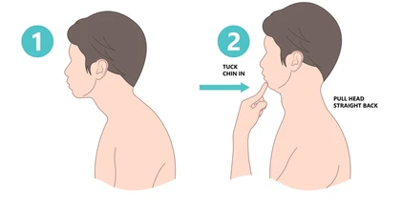
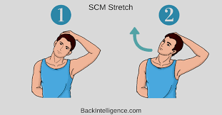
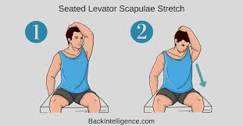
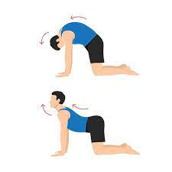
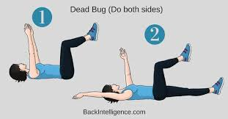
5-minute Home Exercises for long term pain relief
Neck or Back Pain?
1) Rhomboid Squeezes
Start 2 sets of 15
3) Neck Stretches
Hold for 30 sec
4) Cat Cows
2 sets of 10
2) Chin Tucks
Start 2 sets of 15
5) Dead Bugs
Start with 3 sets of 10
1
2
3
3
4
5

Slide 9
Thank you
Anna Kristiansen, SPT
kris2071@pacificu.edu
Lily Soohoo-Hui, SPT
Sooh2713@pacificu.edu
Cora Erickson, SPT
q092166g@pacificu.edu

